Slide 1
Musical Notes Recognition
Cerneanu Valentin
Musteata Cosmin

Slide 2
Our idea
Our idea is to help musicians tune their instruments much easier through our application
The app will tell you how close you are from the real note
So, in case of tuning a guitar, you just need a microphone to record the sound of every string.

Slide 3
What we used
We used librosa python library
First, we record the sound using sounddevice library and store it as a wav file
Then using load method from librosa library we get the audio file as a floating point time series.
Using method effects.hpss(audio_time_series) we decompose the audio time series into harmonic and percussive components

Slide 4
Chromagram
In music, the term chromagram closely relates to the twelve different pitch classes. Chromagrams, also referred to as "pitch class profiles", are a powerful tool for analyzing music whose pitches can be meaningfully categorized
One main property of chroma features is that they capture harmonic and melodic characteristics of music, while being robust to changes in timbre and instrumentation.

Slide 5
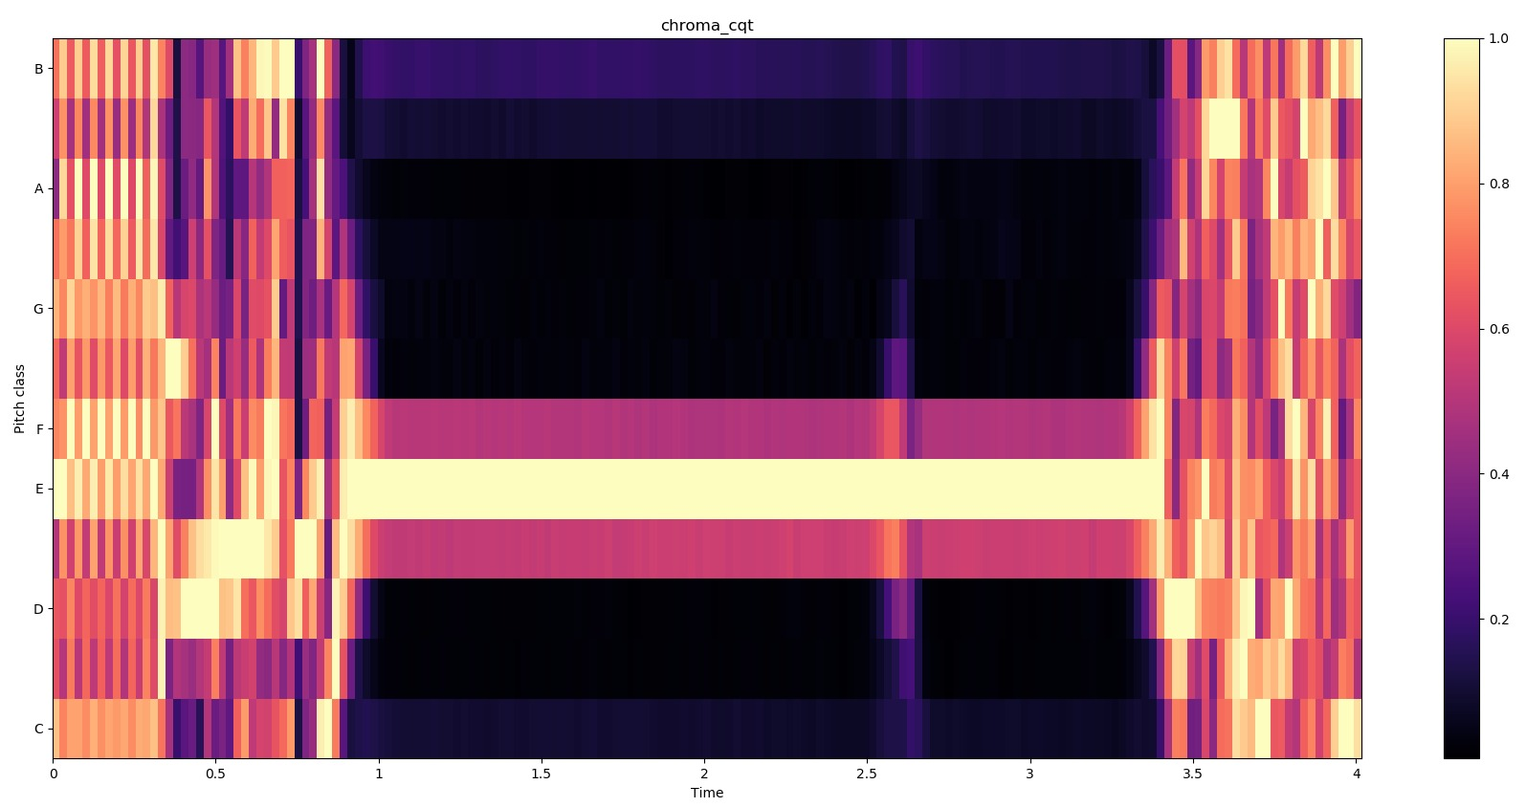
Chromagram for E note

Slide 6
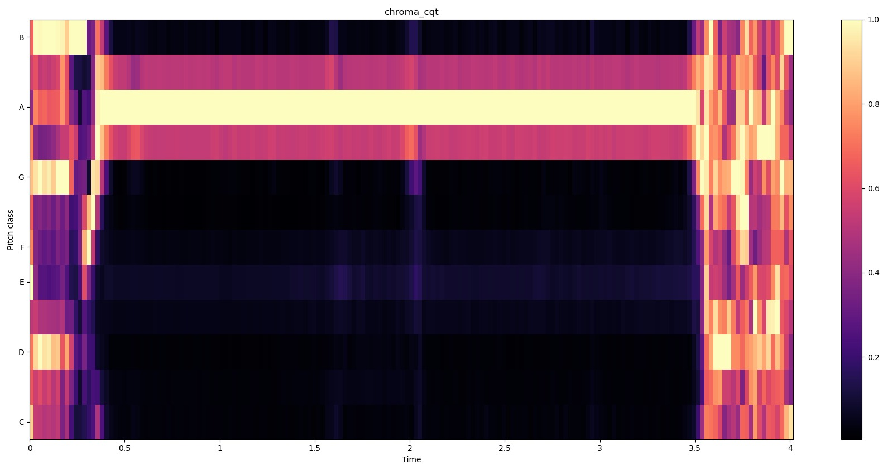
Chromagram for A note

Slide 7
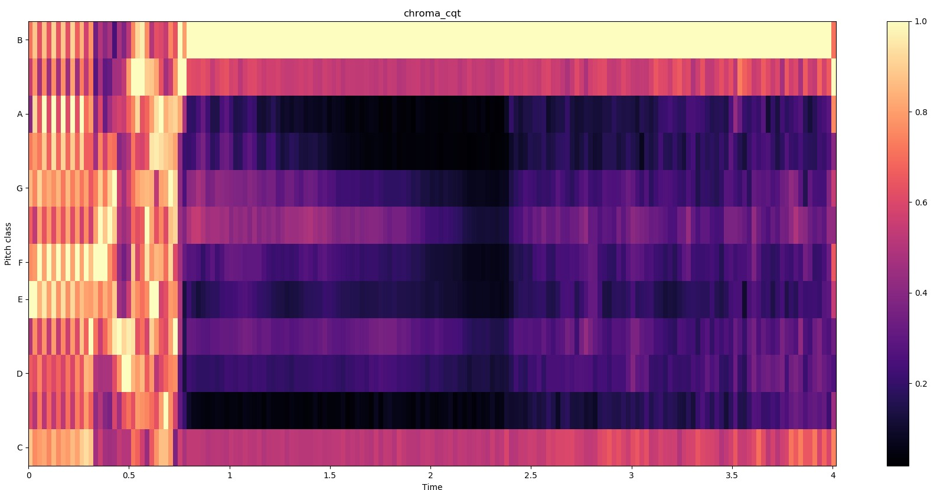
Chromagram for B note

Slide 8
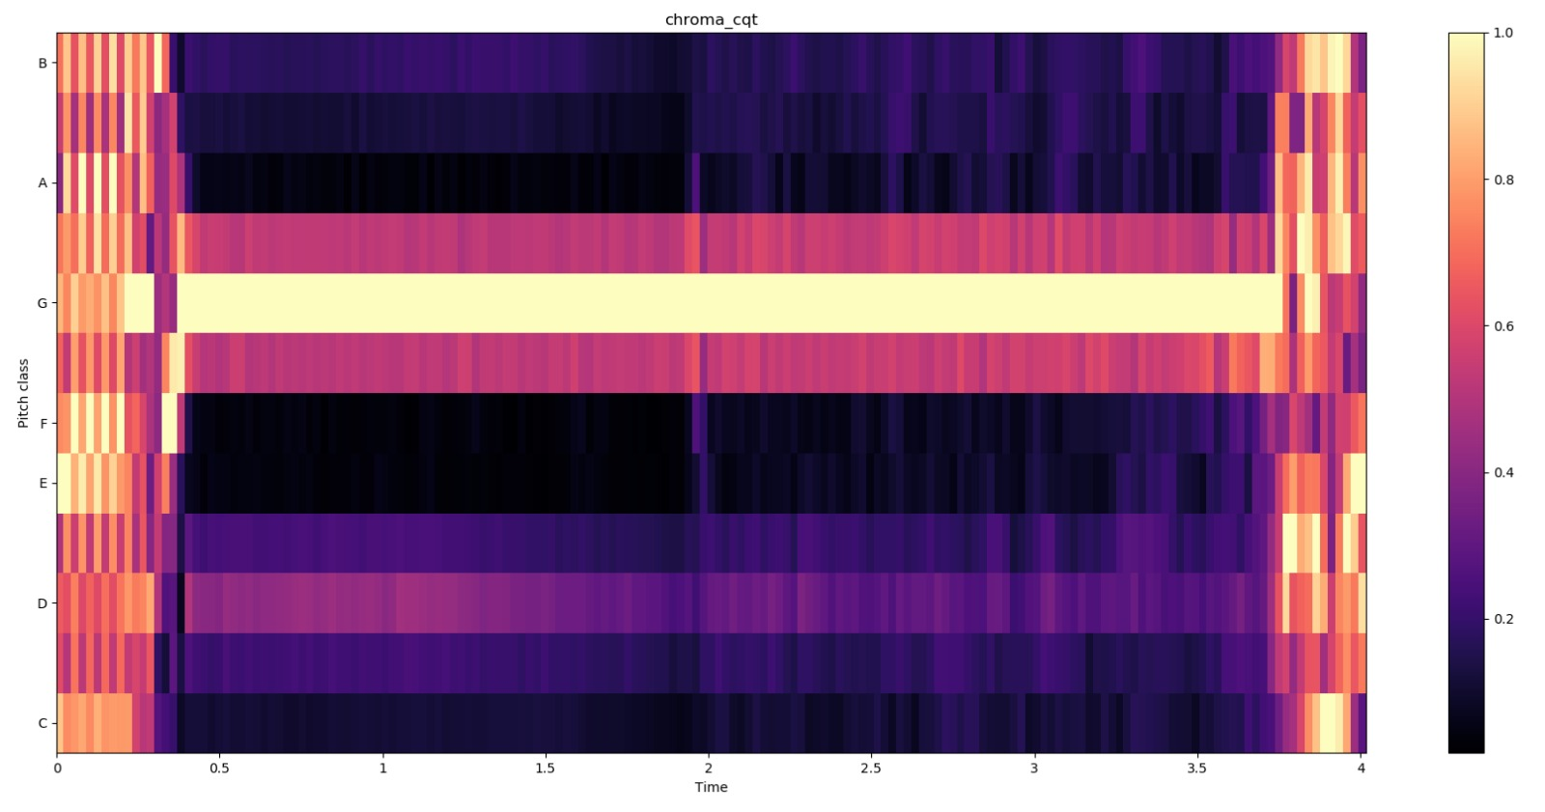
Chromagram for G note

Slide 9
References
For generating sounds with a given frequency https://www.szynalski.com/tone-generator/
For generating musical notes https://tuner-online.com/by-ear/
Librosa library documentation https://librosa.github.io/librosa/

Slide 10
GitHub Repository
https://github.com/ValentinCerneanu/Musical-Notes-Recognition

